Slide 1
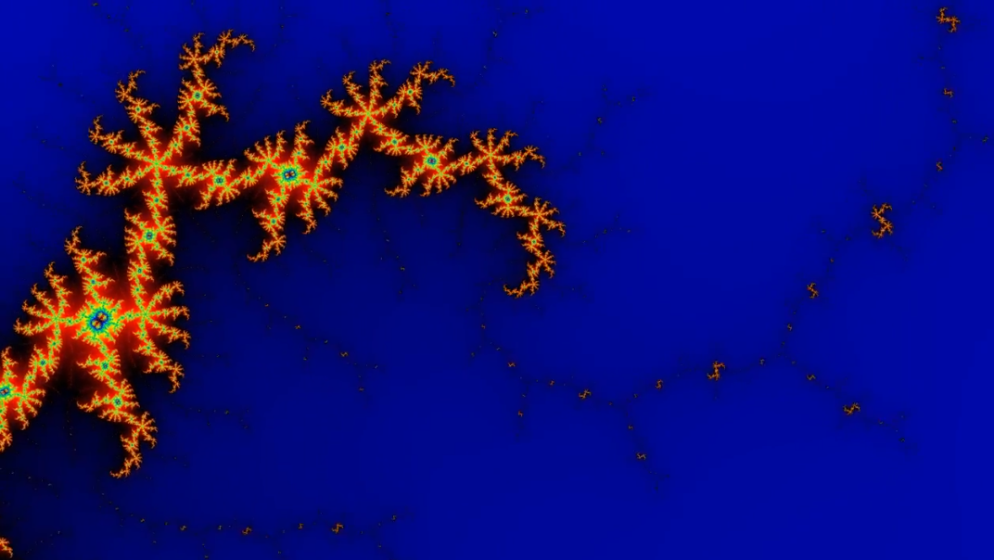
Gsflow-Arcpy
Introduction to the GSFLOW development toolkit
Presenter: Murphy Gardner

Slide 2
What is Gsflow-Arcpy?
Suite of Python scripts that apply Arcpy functions to input datasets and return GSFLOW input parameters
Shapefile attribute table
PRMS parameter files
SFR input data for MODFLOW
Documentation
Gardner et al 2018 – Environmental Modeling and Software Journal
GitHub repository – includes scripts, templates, examples, and tutorial
Jupyter workbooks

Slide 3
Setup: Computing and Data
Computing needs
Data needs
Arc GIS 10.1 or newer
Python 2.7
Cascade routing tool (CRT, v 1.3.1)
USDA Soil Data Viewer (v 6.2)
GSFLOW (v 1.1.6 or newer)
Digital Elevation Model (DEM)
Model boundary and model points shapefile
Vegetation and Soil data
Impervious coverage
PRISM or other gridded climate data
Observed station data

Slide 4
Pre-process: Model Boundary and Points
Need model boundary and model points shapefiles to begin running Gsflow-Arcpy
Model boundary (study_area_path) is a polygon shapefile that delineates the active model domain
Model points (model_points_path) are read from a user created shapefile that defines model outlet, subbasin outlets, and sinks (if any)
If lakes are being modeled, a lake shapefile must also be created (lake_path)

Slide 5
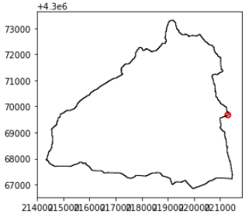
Exercise: Model boundary and model points
Model Boundary
Use the model boundary Jupyter notebook to create watershed boundary
This uses a single gage location and a DEM to create a boundary shapefile in ArcMap
Subbasin points added after initial boundary is built
Other options for creating model boundaries
HUC basins (Geospatial Data Gateway)
HA delineations
Manually drawn in Arc

Slide 6
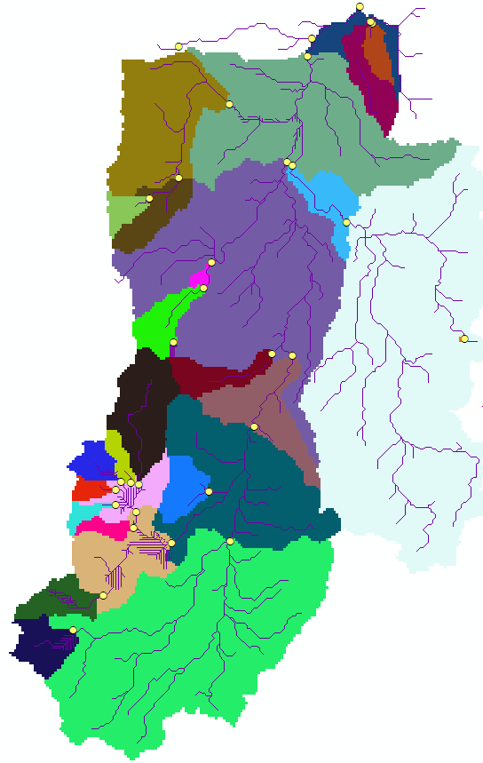
Subbasins in PRMS
To observe flows in within a PRMS model domain, subbasins must be designated
This will provide flow volumes from all contributing HRUs at each subbasin outlet
Subbasin calibration is recommended when more than one streamgage exists in the model domain
To create subbasins, points labeled SUBBSAIN must be added to model points shapefile

Slide 7
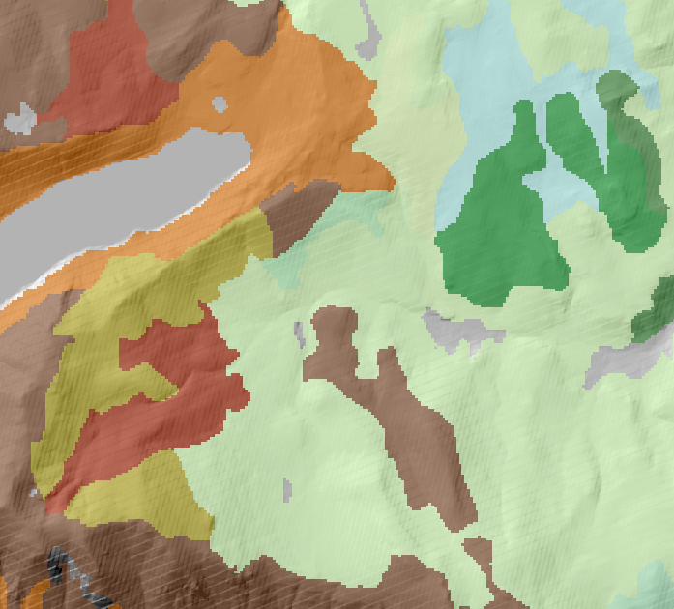
Pre-process: Soil Rasters for Gsflow-Arcpy

Slide 8
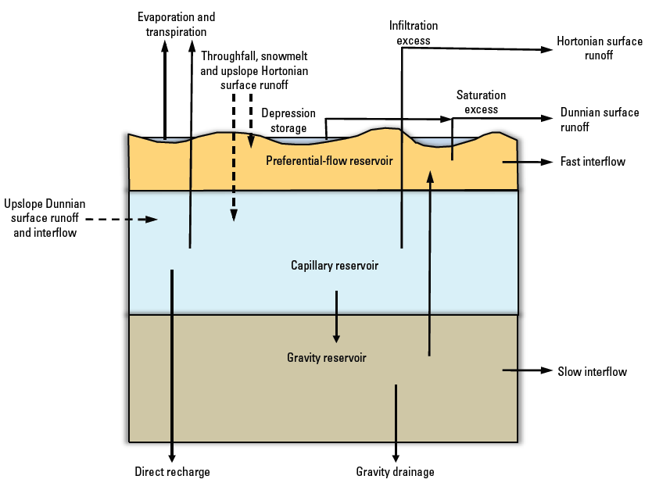
PRMS soilzone parameterization
Soilzone ‘reservoirs’
Preferential, gravity, capillary
Parameterization
Gravity and preferential capacity
sat_threshold
Gravity flow
slowcoef_lin, slowcoef_sq (to HRU)
ssr2gw_rate (to GWR)
Capillary storage
soil_moist_max, soil_rechr_max
Markstrom et al 2015

Slide 9
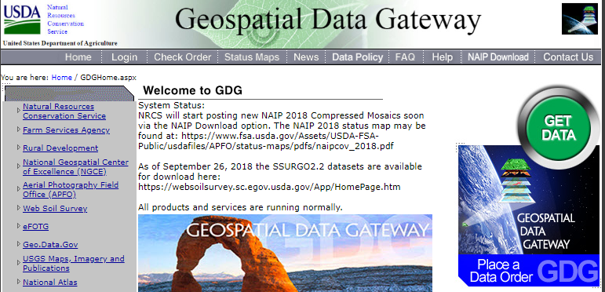
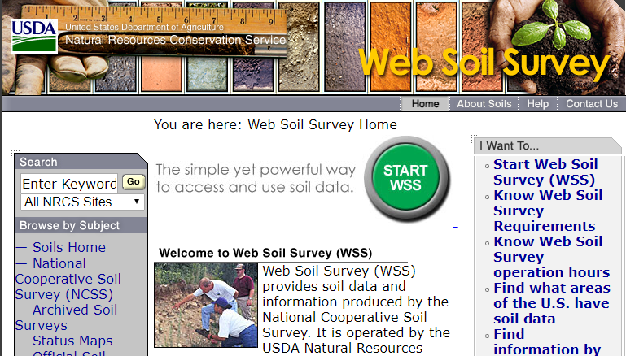
USDA soil survey data available online
Geospatial Data Gateway (link)
Select by State/County
SSURGO, gSSURGO, STATSGO
Web Soil Survey (link)
Delineate area of interest (AOI)
SSURGO and STATSGO

Slide 10
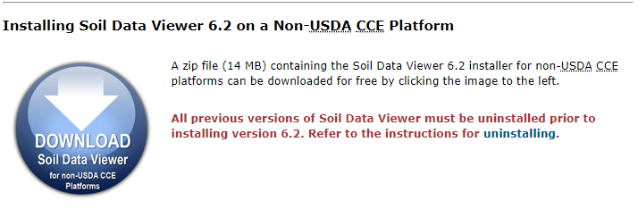
USDA Soil Data Viewer add-in for Arc
Download and install Soil Data Viewer 6.2 (link)
Follow instructions for a non-USDA CCE Platform and register as ArcMap add-in
This may require administrator privileges

Slide 11
Exercise - Import soil data
Unzip soil survey folder (from USDA download) and open the Microsoft Access database (.mdb) file
In Access:
Disable Macros, Enable Content if prompted
In the ‘SSURGO Import’ pop-up window, paste the filepath to the ‘tabular’ data folder (will be included with the soil data download)
Soil data will take a couple minutes to load into Access
Once soil data has loaded into Access, open spatial data in ArcMap (soilmu_a_aoi.shp in the ‘spatial’ data folder)
In ArcMap:
Open Soil Data Viewer
If prompted to select a database, select the Access database file that you have just imported
When prompted to select a soil map layer, select the ‘soilmu_a_aoi’ shapefile that is open in ArcMap – This will bring up the Soil Data Viewer window

Slide 12
Exercise - Import Soil Data (contnd)
In Soil Data Viewer:
Select ‘Advanced Mode’
Select ‘Soil Physical Properties’ under Attribute Folders tab
PRMS requires the following soil properties:
Available Water Capacity (AWC)
Percent sand, clay, and silt (Gsflow-Arcpy only requires sand and clay percents and the remaining percentage is assigned to silt)
Saturated Hydraulic Conductivity (Ksat)
Select these (one at a time) from the drop down list of ‘Soil Physical Properties’
Set ‘Rating Options’
Recommended:
‘Weighted Average’ for Aggregation Method
‘Higher’ for the Tie-Break Rule
‘All Layers’ for Layer Options
Click ‘MAP’ to import the soil property into Arc
A shapefile of the soil property will appear in ArcMap

Slide 13
Exercise - Import Soil Data (contnd)
Use the Conversion Toolbox in ArcMap to convert the soil data to a raster image
In Conversion Tools, under the ‘To Raster’ option, select ‘Polygon to Raster’
For ‘Input Features’, select a soil property shapefile that was imported from the Soil Data Viewer
Choose the soil property (i.e. AWC, Sand, KSAT) for the ‘Value Field’
Assign a folder location and file name with extension .img for the ‘Output Raster Dataset’ (i.e. ‘ksat.img’)
Keep the default inputs for ‘Cell assignment type’, ‘Priority field’, and ‘Cellsize’
Click ok and observe the raster image in ArcMap

Slide 14

Overview of Gsflow-Arcpy components

Slide 15
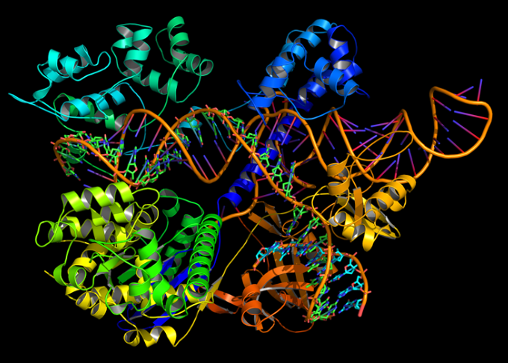
Configuration file (.ini)
Folder paths
Arcpy operational settings
Model specifications
Stream network settings
Observed climate data
Parameter and dimension CSV
Parameter file setup
Config parser Jupyter workbook

Slide 16
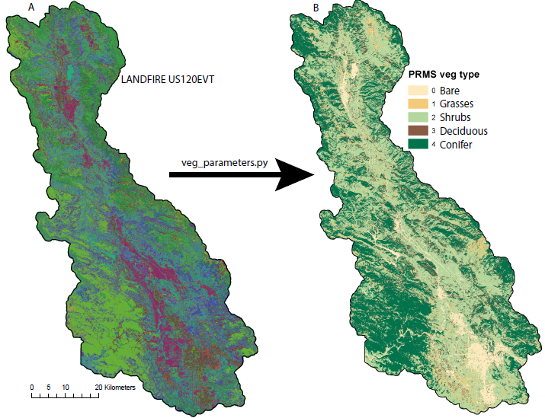
Remap files
Example: coverage type
What are they and what are they used for?
Coverage type
Coverage density (summer/winter)
Snow and rain interception (summer/winter)
Root depth
Temp adjust
Gardner and others 2018

Slide 17
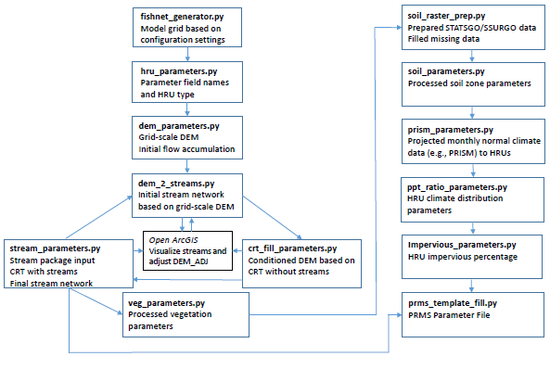
Executing the scripts
Order of operations
Iterate for stream network
Check progress in ArcGIS
Batch file
Gardner and others 2018

Slide 18
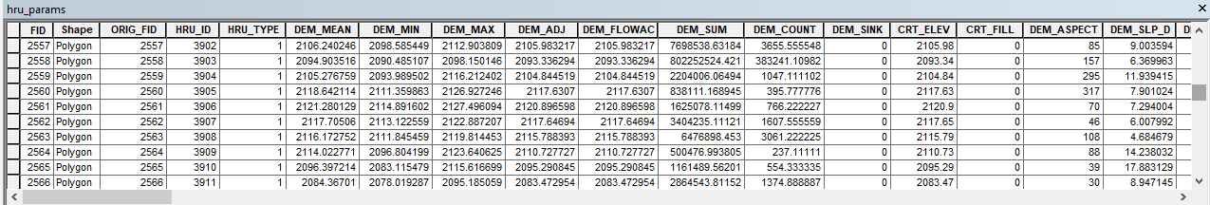
HRU parameter shapefile (.shp)
Shapefile that stores all parameter info as scripts are run
Raster files
.dbf file
Go to Jupyter workbook to begin!

Slide 19
Stream Network and Cascade Routing
Initial stream network is based on the initial DEM_ADJ (unfilled)
Cascade routing tool (CRT) is used to fill the DEM_ADJ
Manually filling can also take place
CRT (Henson et al 2013) defines flow paths within a grid-based watershed model for every model grid cell (HRU)
Once CRT has filled and assigned cascades per HRU, a final stream network is composed

Slide 20
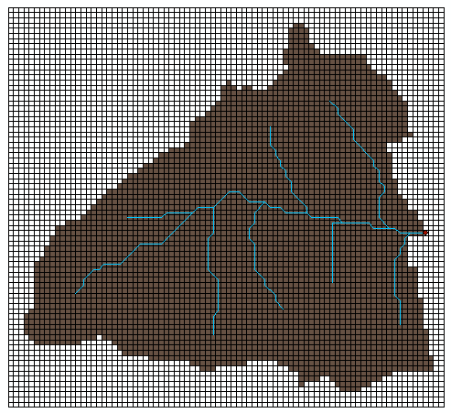
CRT fill and stream network development
Swales/sinks
Streams/lakes
Flow length/accum thresholds
CRT fill and manual adjustments
CRT fill flag
Iterate
Go to Jupyter workbooks to build a stream network!

Slide 21
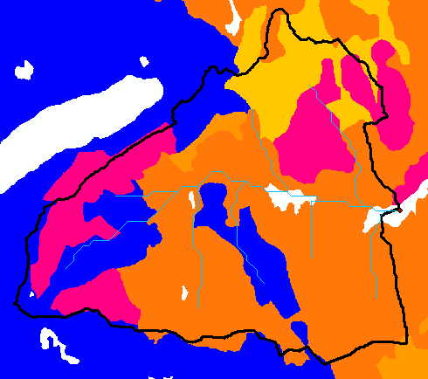
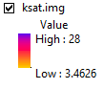
Vegetation and Soil input
Veg
LANDFIRE database
EVT140 and EVC140
Attribute data dictionary
Check remap files
Soil
USDA data portals
SSURGO and/or STATSGO
Soil Data Viewer
Make raster images
Go to Jupyter workbooks to run the veg and soil scripts!

Slide 22
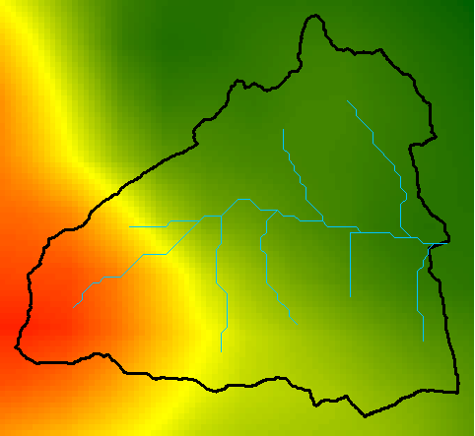
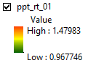
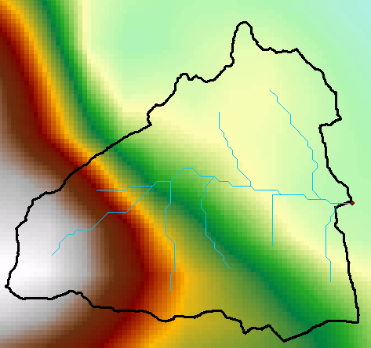
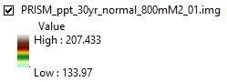
Climate distribution
PRISM-to-station relationships
PPT/temperature zones
Station records
PRMS modules

Slide 23
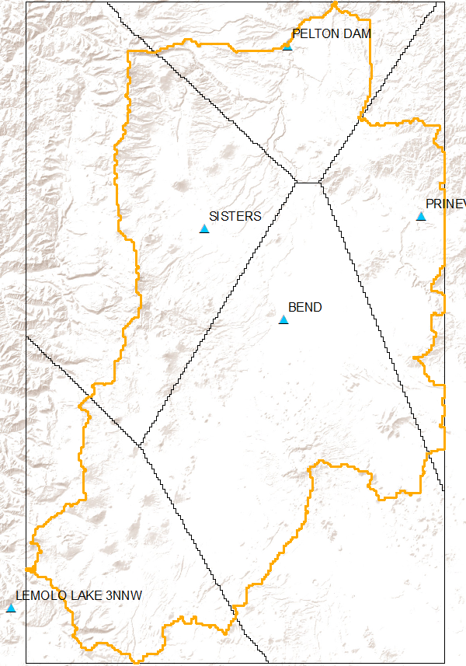
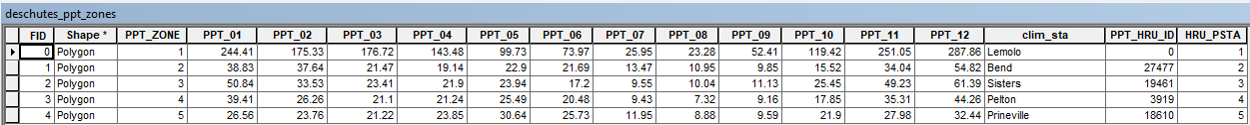
Precipitation and temperature zones
Shapefile that designates the zones and holds mean monthly observed data in the attribute table
Scripts use the shapefile to assign HRUs climate distribution values based on the zone they fall into
Go to Jupyter workbooks to run the climate scripts!

Slide 24
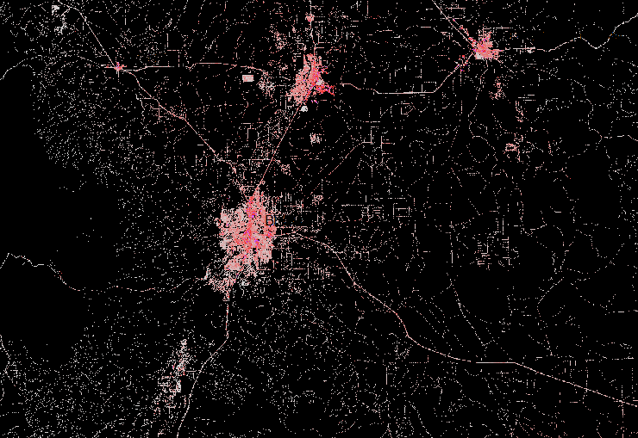
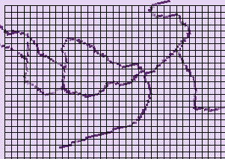
Impervious cover
Recommended – NLCD Impervious coverage 2011 (link)
impervious_parameters.py
Outputs a percent impervious per HRU

Slide 25
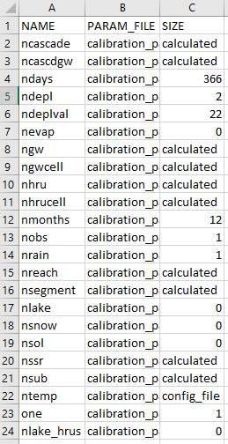
PRMS parameter files
Config file settings
Array or column mode
Single or multiple
CSV files
Dimension and parameter settings
Go to Jupyter workbooks to run the impervious and parameter file scripts!

Slide 26

Configuration File for Gsflow-Arcpy

Slide 27
Folder/file paths
Specific to project names and local folders
Gsflow-Arcpy is executed from the location of the configuration file
Templates available with the Gsflow-Arcpy GitHub repository

Slide 28
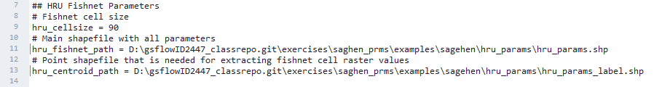
Fishnet
Framework grid
Set cell size
Fishnet and centroid path need the same root name

Slide 29
Fishnet continued
If creating new fishnet, no reference coordinates needed
Just need model boundary and model points shapefiles
If using an existing fishnet, this step can be skipped, or reference coordinates can be used to snap to an existing grid
Buffer cells – cells beyond model boundary

Slide 30
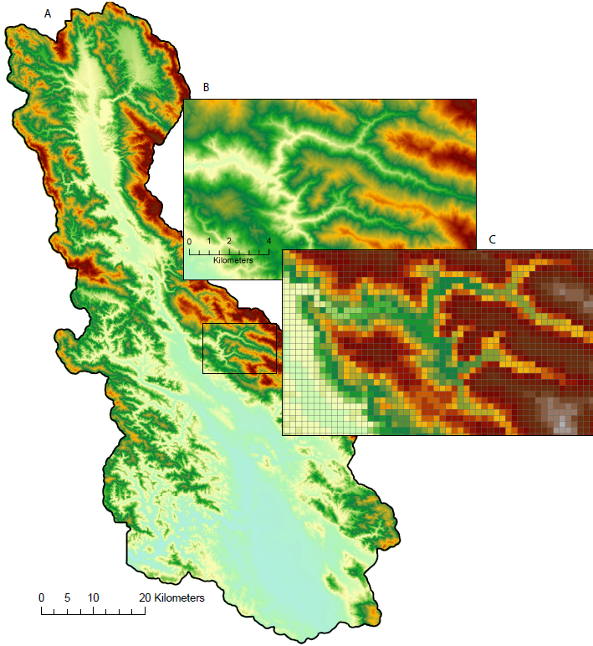
DEM
Recommended - IMG file from USGS portal (link)
Set filepath (dem_orig_path)
Specify original units and resolution
Flow accumulation weighted
Initial temperature adjust is based on HRU aspect
Gardner et al 2018

Slide 31
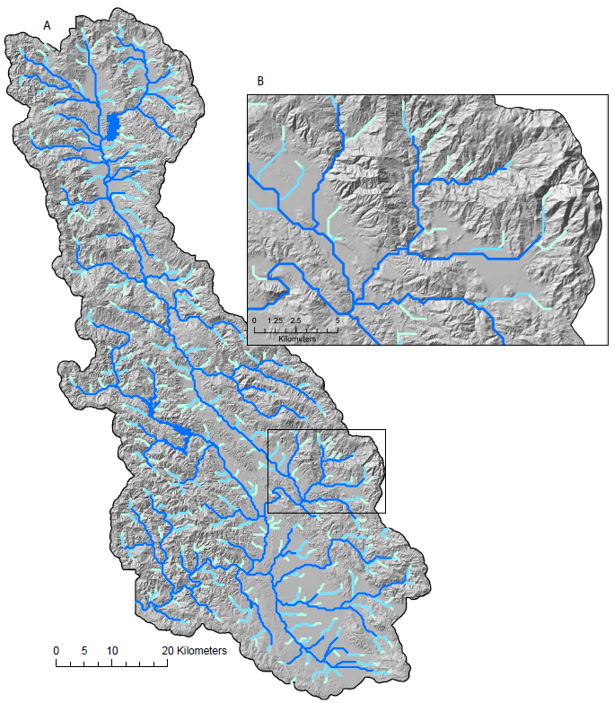
Stream Network
Flow accumulation and flow length thresholds
Adjust to determine level of detail
Iterative process
Initial network
CRT fill
Re-build streams after fill
Final cascades
Gardner et al 2018

Slide 32
CRT
Runs first without streams, to fill DEM as necessary (crt_fill_parameters.py)
use_crt_fill_flag = True (automatically adjusts DEM_ADJ with CRT fill values)
If set to False, DEM_ADJ values won’t change, fill amounts stored in CRT_FILL
CRT runs again with streams (stream_parameters.py)
Stream scripts must be re-run if any adjustments to DEM are made

Slide 33
Vegetation and Soil
Set filepaths to existing vegetation type/cover data files (LANDFIRE link)
Remap files
Soil scripts read rasters created with Soil Data Viewer
Available water capacity (AWC)
Percent sand, silt, clay
Saturated hydraulic conductivity (Ksat)
Option for ssr2gw_rate multiplier
User created shapefile holding multipliers to define recharge zones, for example
If no shapefile, default multiplier will be applied (ssr2gw_k_default)
Option for soil depth
If not provided, root depth will be used

Slide 34
Climate data
Single climate station
Mean-monthly PPT data to distribute based on the station-to-PRISM relationship
Temperature adjust based on aspect (default)
Multiple climate stations
Designate sections of the model area to be driven by different climate stations (precip and temp zone shapefiles)
Temperature adjustment can be based on station-to-PRISM relationship like PPT

